Slide 1
19CSE211
Term2
Pipeline in MIPS
23-02-2021

Slide 2


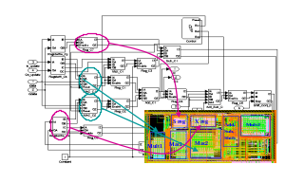
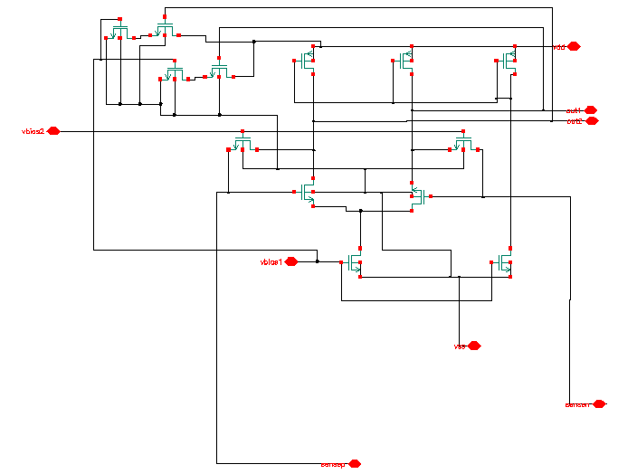
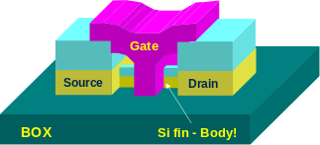
The Big Picture
SPEC
Requirements
Problem Focus
f1
f2
Algorithms
i
p
f5
f3
s
q
j
f2() {
f3(s2, &j, &i);
*s2->p = 10;
i = *s2->q + i;
}
fp
f3
Prog. Lang./OS
f4
ISA
i1: ld r1, b <p1>
i2: ld r2, c <p1>
i3: ld r5, z <p3>
i4: mul r6, r5, 3 <p3>
i5: add r3, r1, r2 <p1>
uArch
Performance Focus
Circuit
Device
Notes:
The big picture. Talk about the levels of abstraction. Talk about the fact that this is where all programs get ushered into hardware execution.
Circuits are increasing providing both opportunities (resources, bandwidth) and challenges (noise, power).
Circuits are locally designed; software is globally intertwined
Software is increasingly over designed for portability and productivity.
The path between the two domains is increasingly stressed and inadequate due to this mismatch.
The focus of the thrust is to provide a very strong path from the productivity oriented software domain into the performance oriented hardware domain.
Translate device/circuit level innovations into visible benefit at the application/software level!

Slide 3
Introduction
A.1 What is Pipelining?
A.2 The Major Hurdle of Pipelining-Structural Hazards
  Data Hazards
  Control Hazards
A.3 How is Pipelining Implemented
A.4 What Makes Pipelining Hard to Implement?
A.5 Extending the MIPS Pipeline to Handle Multi-cycle Operations

Slide 4
What Is Pipelining
Laundry Example
Ramesh, Suresh, Dinesh, Vignesh each have one load of clothes to wash, dry, and fold
Washer takes 30 minutes
Dryer takes 40 minutes
“Folder” takes 20 minutes
A
B
C
D

Slide 5
What Is Pipelining
6 PM
7
8
9
10
11
Midnight
Time
30
40
20
30
40
20
30
40
20
30
40
20
T
a
s
k
O
r
d
e
r
A
B
C
D
Sequential laundry takes ----- hours for 4 loads
If they learned pipelining, how long would laundry take?

Slide 6
What Is Pipelining
6 PM
7
8
9
10
11
Midnight
Time
30
40
20
30
40
20
30
40
20
30
40
20
T
a
s
k
O
r
d
e
r
A
B
C
D
Sequential laundry takes 6 hours for 4 loads
If they learned pipelining, how long would laundry take?

Slide 7
What Is Pipelining
Start work ASAP
6 PM
7
8
9
10
11
Midnight
Time
30
40
40
40
40
20
T
a
s
k
O
r
d
e
r
A
Pipelined laundry takes ---- hours for 4 loads
B
C
D
Appendix A - Pipelining

Slide 8
What Is Pipelining
Start work ASAP
6 PM
7
8
9
10
11
Midnight
Time
30
40
40
40
40
20
T
a
s
k
O
r
d
e
r
A
Pipelined laundry takes 3.5 hours for 4 loads
B
C
D
Appendix A - Pipelining

Slide 9
Pipelining Lessons
What Is Pipelining
6 PM
7
8
9
Pipelining doesn’t help latency of single task, it helps throughput of entire workload
Pipeline rate limited by slowest pipeline stage
Multiple tasks operating simultaneously
Potential speedup = Number of pipe stages
Unbalanced lengths of pipe stages reduces speedup
Time to “fill” pipeline and time to “drain” will also reduces speedup
Time
T
a
s
k
O
r
d
e
r
30
40
40
40
40
20
A
B
C
D

Slide 10
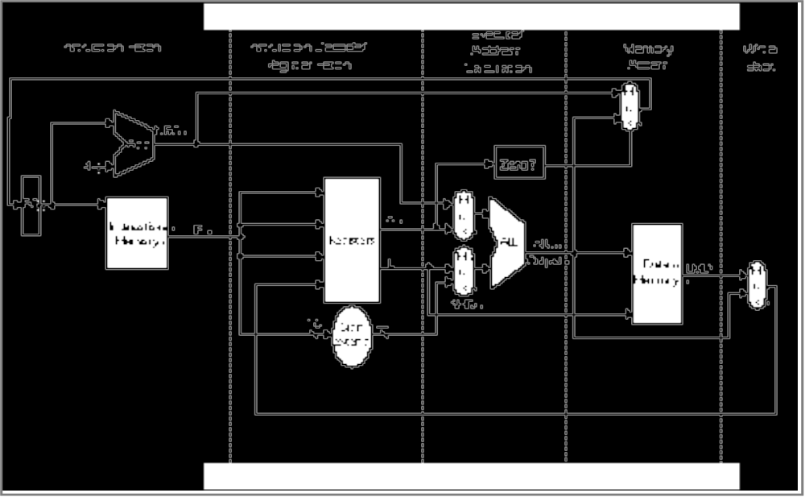
MIPS Without Pipelining
What Is Pipelining
Instruction
Fetch
Instr. Decode
Reg. Fetch
Execute
Addr. Calc
Memory
Access
Write
Back
IR
L
M
D

Slide 11
MIPS Functions
What Is Pipelining
Instruction
Fetch
Instr. Decode
Reg. Fetch
Execute
Addr. Calc
Memory
Access
Write
Back
Passed To Next Stage
IR <- Mem[PC]
NPC <- PC + 4
IR
L
M
D
Instruction Fetch (IF):
Send out the PC and fetch the instruction from memory into the instruction register (IR); increment the PC by 4 to address the next sequential instruction.
IR holds the instruction that will be used in the next stage.
NPC holds the value of the next PC.

Slide 12
MIPS Functions
What Is Pipelining
Instruction
Fetch
Instr. Decode
Reg. Fetch
Execute
Addr. Calc
Memory
Access
Write
Back
Passed To Next Stage
A <- Regs[IR6..IR10];
B <- Regs[IR10..IR15];
Imm <- ((IR16) ##IR16-31
IR
L
M
D
Instruction Decode/Register Fetch Cycle (ID):
Decode the instruction and access the register file to read the registers.
The outputs of the general purpose registers are read into two temporary registers (A & B) for use in later clock cycles.
We extend the sign of the lower 16 bits of the Instruction Register.

Slide 13
MIPS Functions
What Is Pipelining
Instruction
Fetch
Instr. Decode
Reg. Fetch
Execute
Addr. Calc
Memory
Access
Write
Back
Passed To Next Stage
A <- A func. B
cond = 0;
IR
L
M
D
Execute Address Calculation (EX):
We perform an operation (for an ALU) or an address calculation (if it’s a load or a Branch).
If an ALU, actually do the operation. If an address calculation, figure out how to obtain the address and stash away the location of that address for the next cycle.

Slide 14
MIPS Functions
What Is Pipelining
Instruction
Fetch
Instr. Decode
Reg. Fetch
Execute
Addr. Calc
Memory
Access
Write
Back
Passed To Next Stage
A = Mem[prev. B]
or
Mem[prev. B] = A
IR
L
M
D
MEMORY ACCESS (MEM):
If this is an ALU, do nothing.
If a load or store, then access memory.

Slide 15
MIPS Functions
What Is Pipelining
Instruction
Fetch
Instr. Decode
Reg. Fetch
Execute
Addr. Calc
Memory
Access
Write
Back
Passed To Next Stage
Regs <- A, B;
IR
L
M
D
WRITE BACK (WB):
Update the registers from either the ALU or from the data loaded.

Slide 16
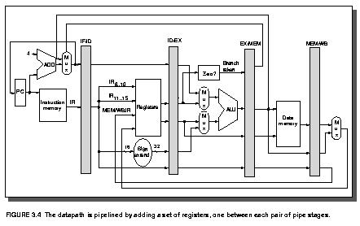
The Basic Pipeline For MIPS
Latches between each stage provide pipelining.

Slide 17
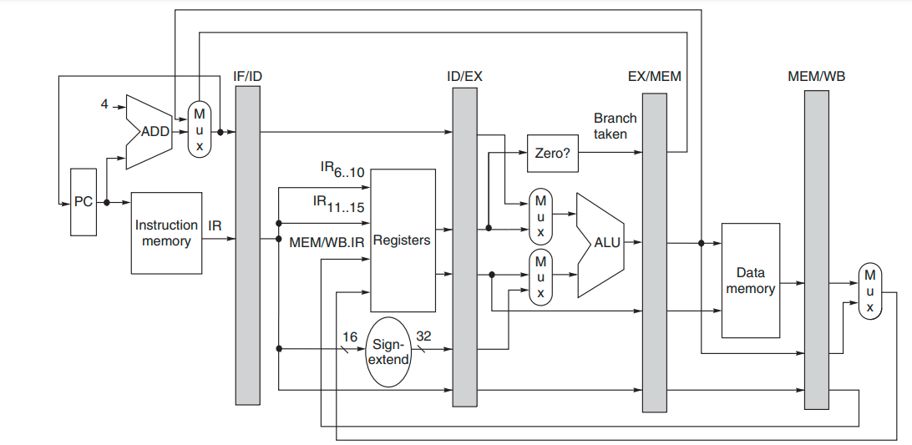

Slide 18
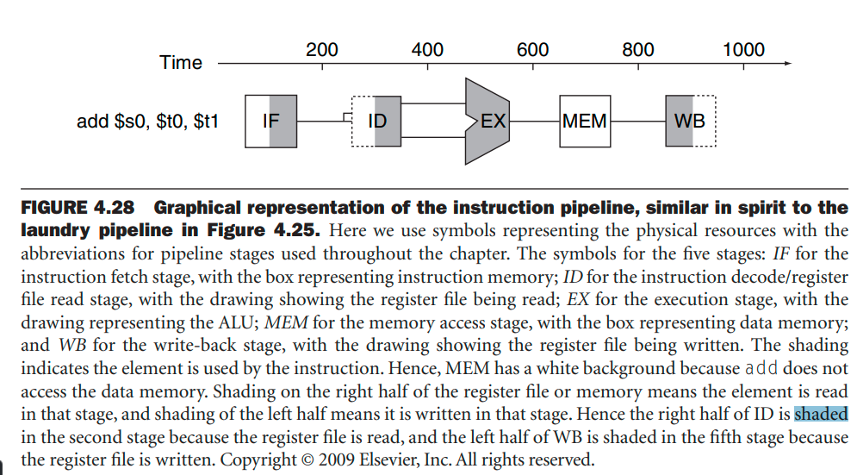
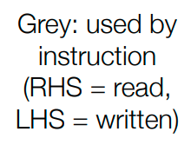

Slide 19
The Basic Pipeline For MIPS
Cycle 1
Cycle 2
Cycle 3
Cycle 4
Cycle 5
Cycle 6
Cycle 7
I
n
s
t
r.
O
r
d
e
r
Ifetch
Reg
ALU
DMem
Reg
Ifetch
Reg
ALU
DMem
Reg
Ifetch
Reg
ALU
DMem
Reg
Ifetch
Reg
ALU
DMem
Reg
Figure 3.3

Slide 20
Pipeline Hurdles
Limits to pipelining: Hazards prevent next instruction from executing during its designated clock cycle
  Structural hazards: HW cannot support this combination of instructions (single person to fold and put clothes away)
  Data hazards: Instruction depends on result of prior instruction still in the pipeline (missing sock)
  Control hazards: Pipelining of branches & other instructions that change the PC
  Common solution is to stall the pipeline until the hazard is resolved, inserting one or more “bubbles” in the pipeline
A.1 What is Pipelining?
A.2 The Major Hurdle of Pipelining-Structural Hazards
-- Structural Hazards
  Data Hazards
  Control Hazards
A.3 How is Pipelining Implemented
A.4 What Makes Pipelining Hard to Implement?
A.5 Extending the MIPS Pipeline to Handle Multi-cycle Operations

